Slide 1

HDL Code Generation using MATLAB/Simulink
Milica Ristović, Slobodan Lubura
University of East Sarajevo, Faculty of Electrical Engineering

Slide 2
Verilog i HDL codes can be generated from one of these models:
- Simulink model;
-Stateflow diagram;
-Embedded MATLAB model.

Slide 3
Steps which are neccessary for HDL Code generation in Simulink:
Design HDL compatible Simulink model;
Data type conversion from floating-point to fixed-point;
Use tool for compatibility check (it leads to eventual errors or problems, made durring generation);
HDL Code Generation;
Analyze of Generated HDL Code;
Implementation of Code on FPGA board or another similar device, analyze of device.

Slide 4
Fixed-point
Application “Simulink Fixed-point” expands possibilities of Simulink environment and enables using Data types in fixed-point format.
Data Type Conversion
fixdt(x,y,z), where x is number of bits, y number of bits of real part, and z number of bits of fractional part.

Slide 5
Panel “HDL Code Generation“

Slide 6
Compatibility check with HDL Coder
Using „HDL Code Generation“ panel: Choosing „Run Compatibility Checker“;
2) Right click on subsystem which HDL Code is going to be generated, choosing HDL Code Generation → Check Subsystem Compatibility;
3) Writing command in command window:
>> checkhdl (‘Name_of_model', ‘Name_of_subsystem');
If model is not COMPLETELY compatible with HDL Coder, code generation will not be done!

Slide 7
HDL Code Generation
Using „HDL Code Generation“ panel: Choosing „Generate“;
2) Right click on subsystem which HDL Code is going to be generated, choosing HDL Code Generation → Generate HDL for Subsystem;
3) Writing command in command window:
>> makehdl (‘Name_of_model', ‘Name_of_subsystem');
Message:
# # # HDL Code Generation Complete
means end of proccess of HDL Code Generation.

Slide 8
Report of generated HDL code
Report has some parts from which we can get these information:
information about version of HDL Code, and creating date;
insight in virtual blocks, which cannot be seen in the model, unlike of real blocks (Simulink blocks), giving us mapping between elements (blocks and subsystems) of model and code:
  Code–model links, clicking them we can see part of subsystem or block that is cide generated for;
  Model–code links, enable to see generated code for any block in the model.
( HDL Code Generation → Navigate to Code )

Slide 9
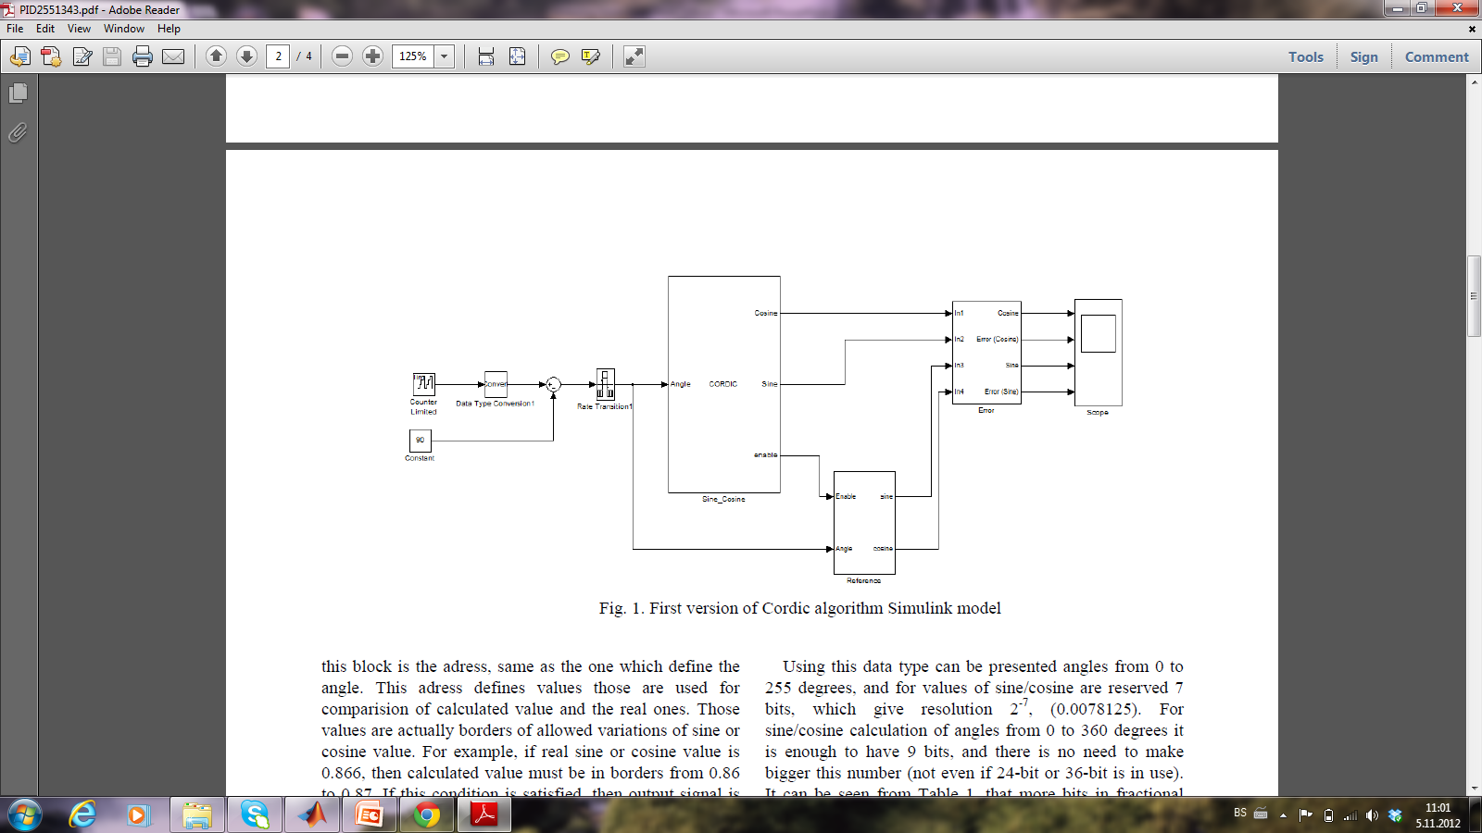
Implementation of CORDIC Algorithm on
FPGA Altera Cyclone II
Coordinate Rotation DIgital Computer - taken from Simulink demos models – adaptation is neccessary

Slide 10
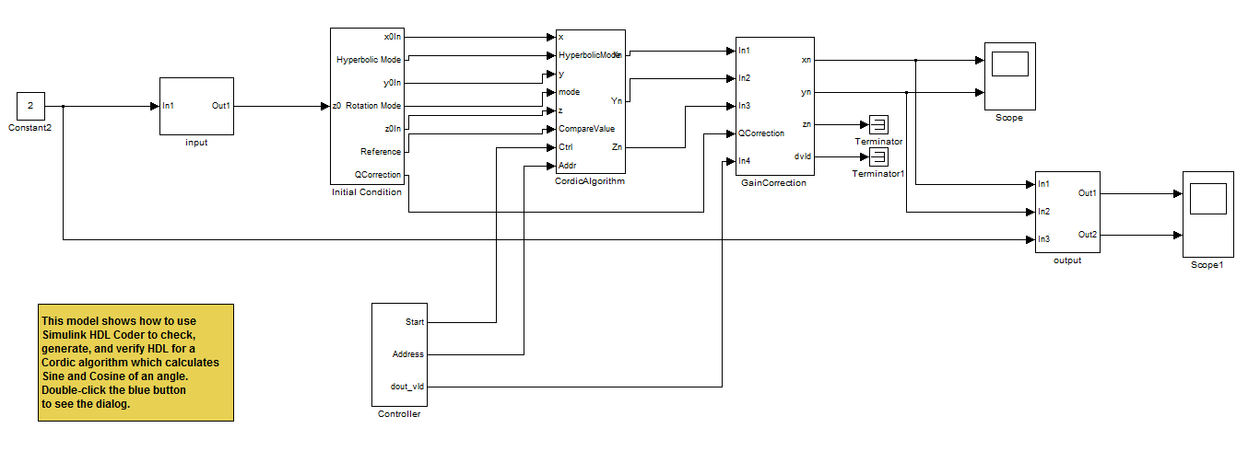
Implementation of CORDIC Algorithm on
FPGA Altera Cyclone II
Adapted CORDIC model:

Slide 11
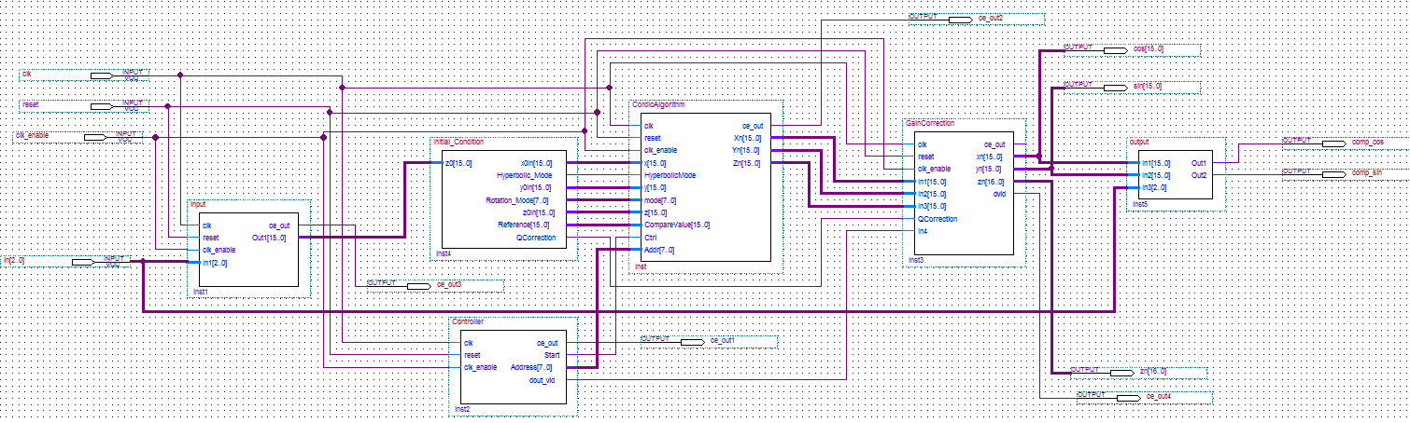
Implementation of CORDIC Algorithm on
FPGA Altera Cyclone II
CORDIC Algorithm model in Quartus:

Slide 12
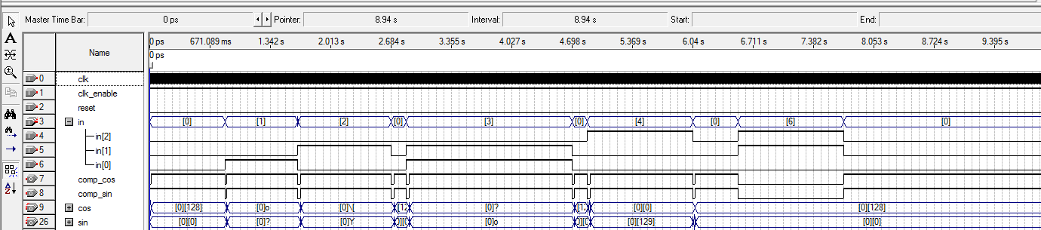
Implementation of CORDIC Algorithm on
FPGA Altera Cyclone II
Waveforms used for testing CORDIC Algorithm in Quartus:

Slide 13
Thank you for attention!!!

